Slide 1

INTRODUCTION TO CLOUD MIGRATION
CLOUD MIGRATION

Slide 2

Cloud migration
WHAT IS A CLOUD MIGRATION STRATEGY?
A cloud migration strategy is a plan that an organization formulates to move all the resources in its infrastructures, such as data, services, and applications, to the cloud.

Slide 3

Types of cloud migration strategies
There are different types of cloud migration strategies that a company can consider following. Gartner calls these the ‘5 Rs of migration strategy’.

Slide 4
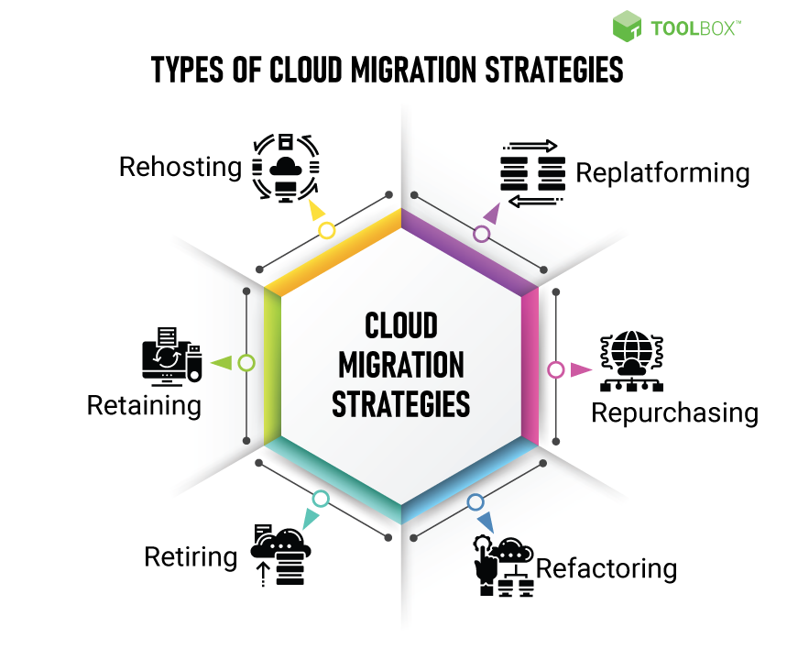
Cloud migration strategies

Slide 5
Cloud migration strategy
REHOSTING
This is more commonly known as the ‘lift and shift’ strategy. It involves transporting a direct copy of the existing infrastructure onto the cloud. This approach makes sense for smaller organizations with simple workloads that are still trying to figure out their long-term plans with respect to services and scalability. It is also ideal for organizations whose infrastructure relies heavily on virtual machines.

Slide 6
Cloud migration strategy
REPLATFORMING
This is also known as the ‘move and improve’ strategy. It involves making bare minimum changes to prepare for the transition to the cloud, including provisions for making scalability easier. The core application architecture remains untouched. It is a small variation of the rehosting strategy.

Slide 7
Cloud migration strategy
REPLATFORMING
This is also known as the ‘move and improve’ strategy. It involves making bare minimum changes to prepare for the transition to the cloud, including provisions for making scalability easier. The core application architecture remains untouched. It is a small variation of the rehosting strategy.

Slide 8
Cloud migration strategy
REFACTORING
The refactoring strategy is essentially rebuilding the entire existing infrastructure from scratch. It is the route taken by organizations that are looking to leverage every single thing that the cloud has to offer, such as serverless computing and auto-scaling. Both these features are difficult to achieve with an on-premise setup.

Slide 9
Cloud migration strategy
RETIRING
Large enterprises often discover components of the infrastructure that have become obsolete or will become inconsequential once moved to the cloud. These modules are not just unnecessary expenditure, they may actually be a security vulnerability as well. In such cases, it simply makes sense to retire these components and not move them to the cloud. Retiring the appropriate modules saves costs and increases security at the same time.

Slide 10
Cloud migration strategy
RETAINING
Sometimes, one or many modules of the existing infrastructure may not be compatible with the cloud platforms in the market. This typically manifests in the form of data that cannot be moved for compliance reasons or architecture that only recently took extra capital to build. In such cases, it makes financial and operational sense to keep these modules on-premise.

Slide 11
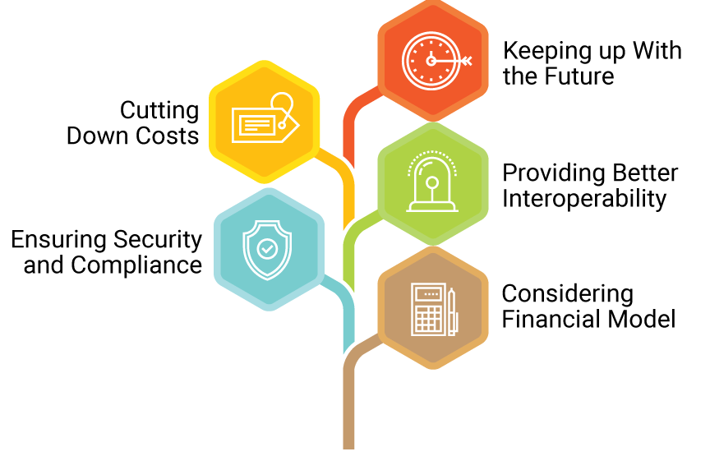
Key Factors Influencing Cloud Migration Strategy for Enterprises

Slide 12
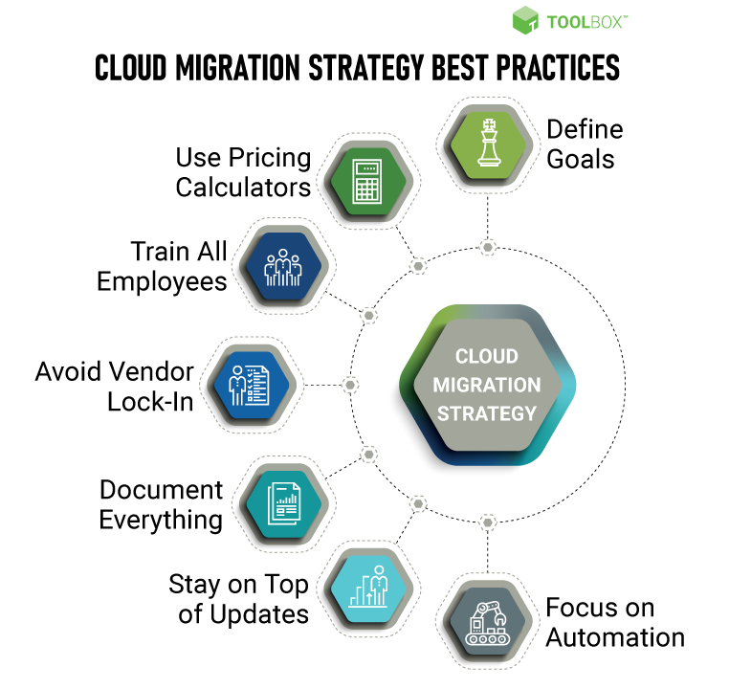
Best Practices

Slide 13

A cloud migration strategy requires careful planning, testing, and resourcing. The stakes are high when a cloud migration process kicks off. Both business and operations need to be secure from the get-go. A good cloud migration strategy needs to ensure that this aspect is taken care of, and the organization leverages the cutting-edge technology of the cloud to surge ahead.
Miration takeaway

Slide 14

LEGACY APPLICATIONS (AND WHAT TO DO WITH THEM)
APPLICATION MODERNIZATION
Challenges to Migration
BUSINESS SUPPORT
COMPLEXITY OF MIGRATING

Slide 15
Serverless applications are intricate, distributed architectures of functions and API calls, and are enclosed within ephemeral containers. Since serverless architecture segregates the code from the infrastructure that is running it.

